Slide 1


Slide 2
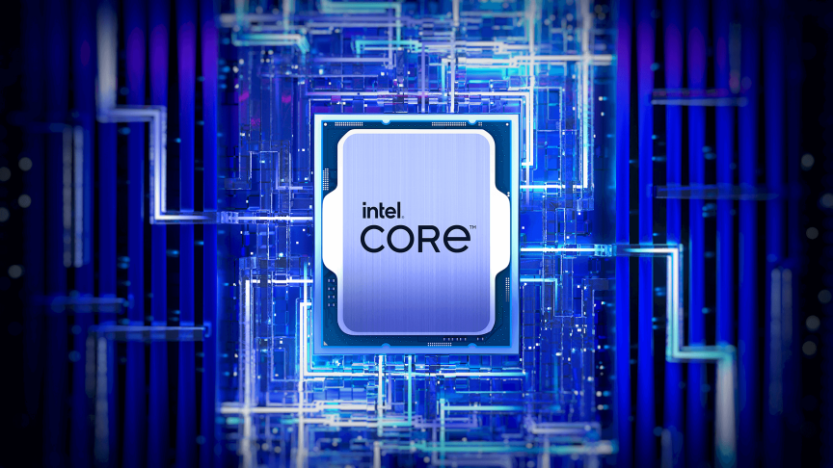
Topic: Running GenAI on Intel AI Laptops and Simple LLM Inference on CPU and fine-tuning of LLM Models using Intel OpenVino.
NAME: UTKARSH
COLLEGE: MANIPAL INSTITUTE OF TECHNOLOGY
Registration No: 210968082
Individual Project

Slide 3

PROBLEM STATEMENT: Running GenAI on Intel AI Laptops and Simple LLM Inference on CPU and fine-tuning of LLM Models using Intel Open VINO
· High Resource Demand: Running GenAI and LLMs typically requires powerful GPUs, limiting accessibility.
· Need for CPU Solutions: There is a pressing need for AI inference and fine-tuning solutions on CPUs, especially for Intel AI laptops.
· Intel OpenVINO Optimization: OpenVINO optimizes AI models to run efficiently on CPUs, reducing costs and energy consumption.
· Democratizing AI: These technologies make advanced AI tools more accessible and portable, fostering innovation and expanding the impact of AI.

Slide 4
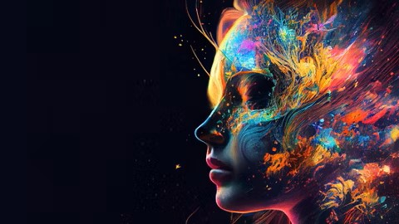
INTRODUCTION TO PROJECT
In this project, we are making advanced artificial intelligence (AI) tools accessible on everyday laptops by using a compact language model called TinyLlama which is the smallest of all llms and thus resource efficient and inferencing it with Intel® OpenVINO™. Our goal is to enable powerful AI capabilities without needing expensive hardware like high-end graphics cards. We are training TinyLlama with a detailed dataset of color descriptions so it can understand and generate rich information about different colors. Users simply type a color name or color code into their laptop, and TinyLlama processes this input to produce a detailed, easy-to-read description of the color, which is then displayed on the screen. This makes advanced AI technology more affordable and available to everyone.

Slide 5
Unique Idea Brief - 1
Enabling Advanced AI on Intel AI Laptops
TinyLlama Model:Compact and Efficient: TinyLlama is a compact language model optimized for performance and resource efficiency, making it ideal for deployment on devices with limited computational power.
Intel® OpenVINO™ Optimization:Efficient AI Inference: Utilizes OpenVINO to optimize TinyLlama for efficient CPU inference, significantly enhancing performance on Intel AI laptops without the need for expensive GPUs

Slide 6


Unique Idea Brief - Part 2
Enabling Advanced AI on Intel AI Laptops
LoRA Technique:
Advanced Fine-Tuning: Implements Low-Rank Adaptation (LoRA) for efficient fine-tuning of TinyLlama. LoRA reduces the number of trainable parameters, making the fine-tuning process faster and more resource-efficient.
Generative AI (GenAI):
Enhanced Capabilities: Integrates Generative AI techniques to enable TinyLlama to generate detailed and contextually rich outputs, such as color descriptions, from given inputs.
Dataset Utilized:
Color Descriptions Dataset: Fine-tunes TinyLlama using a comprehensive dataset that includes detailed descriptions and hexadecimal codes of various colors. This showcases the model's practical application in generating rich and accurate color-related information.

Slide 7

Features Offered by the Project on Colors dataset
• Efficient AI Inference:
Optimized performance using Intel® OpenVINO™ for running TinyLlama on Intel AI laptops, reducing the dependency on expensive GPUs.
• Advanced Fine-Tuning:
Utilizes Low-Rank Adaptation (LoRA) for efficient fine-tuning, which reduces trainable parameters and accelerates the fine-tuning process.
• Comprehensive Color Descriptions:
Fine-tuned with a detailed color descriptions dataset, enabling the generation of rich and accurate color information.
• Generative AI Capabilities:
Integrates Generative AI techniques to produce detailed and meaningful outputs, such as generating precise and contextually rich color descriptions.
• Accessibility and Portability:
Optimized for CPU usage, making advanced AI tools accessible on standard hardware, enhancing portability, and reducing costs.

Slide 8
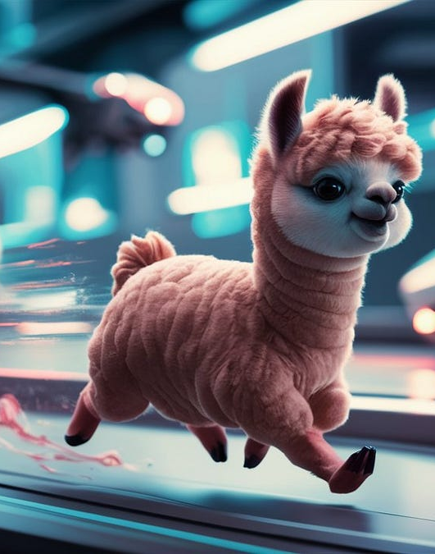
BASE MODEL: TINY LLAMA-1.1B
TinyLLaMA 1.1 is a compact language model with 1.1 billion parameters, designed for efficient deployment in environments with limited computational and memory resources. It shares its architecture and tokenizer with LLaMA 2, making it compatible with many existing projects based on LLaMA. This model has been pretrained on 3 trillion tokens, offering robust performance despite its relatively small size.
Key features of TinyLLaMA 1.1 include:
Compact Size: With only 1.1 billion parameters, it is suitable for applications requiring lower computational and memory overheads.
Architecture: It follows the same architecture as LLaMA 2, ensuring compatibility and ease of integration with existing LLaMA-based projects.
Training Data: The model is trained on a mixture of datasets, including SlimPajama and Starcoderdata, with a total of around 950 billion tokens processed during training.
Performance: Despite its smaller size, TinyLLaMA performs well on various commonsense reasoning and problem-solving benchmarks, often outperforming other models in its parameter range.

Slide 9
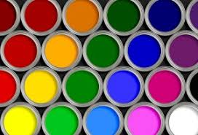
Dataset: Colors
· Content: The dataset includes color names and their respective RGB values stored in a CSV format. It is designed for tasks such as color recognition and generation. For instance, it might be used to train models that assist color-blind individuals in recognizing and differentiating colors.
· Structure: The dataset is organized into directories based on common colors. Each directory contains images that prominently feature the respective color, helping to train models to recognize and categorize colors accurately. For example, directories may include images named blue_car.jpg and red_dress.jpg in their respective blue and red directories​​.
· Applications: This dataset can be used in various machine learning tasks, including color classification, text generation related to color descriptions, and text-to-image generation where accurate color depiction is crucial. It is particularly useful in developing tools for color-blind individuals and enhancing real-time machine translation systems for color descriptions​.
· Training Data and Sources: Images within the dataset are often sourced from the internet and are categorized to cover a wide range of colors. Contributors are encouraged to provide high-quality images with appropriate licensing to improve the dataset's diversity and compliance.

Slide 10
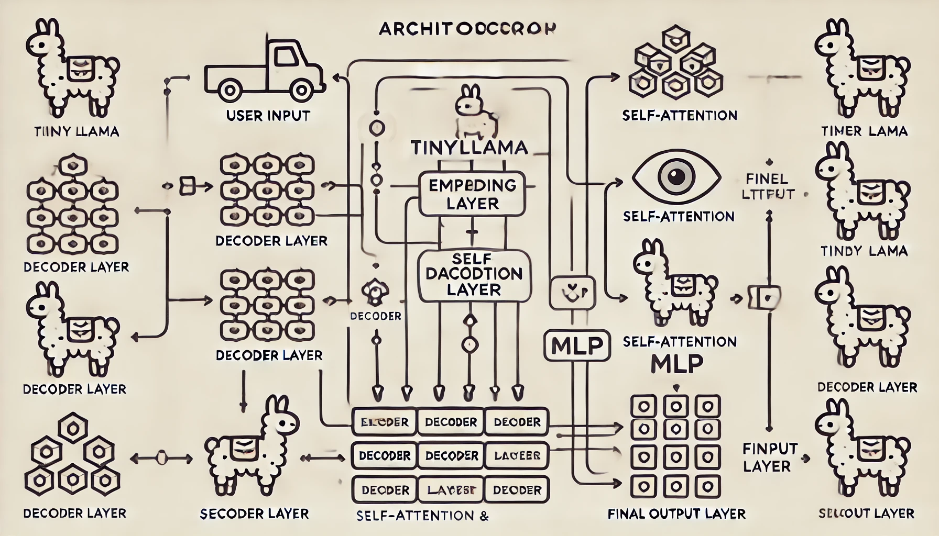
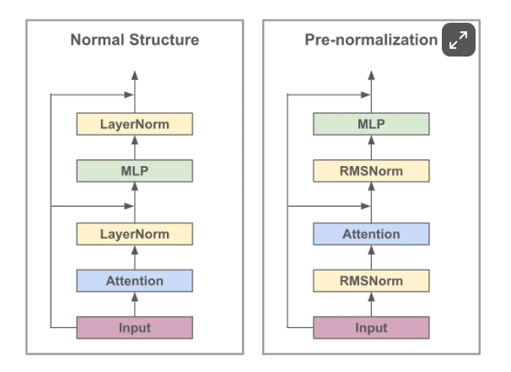
ARCHITECTURE DIAGRAM

Slide 11
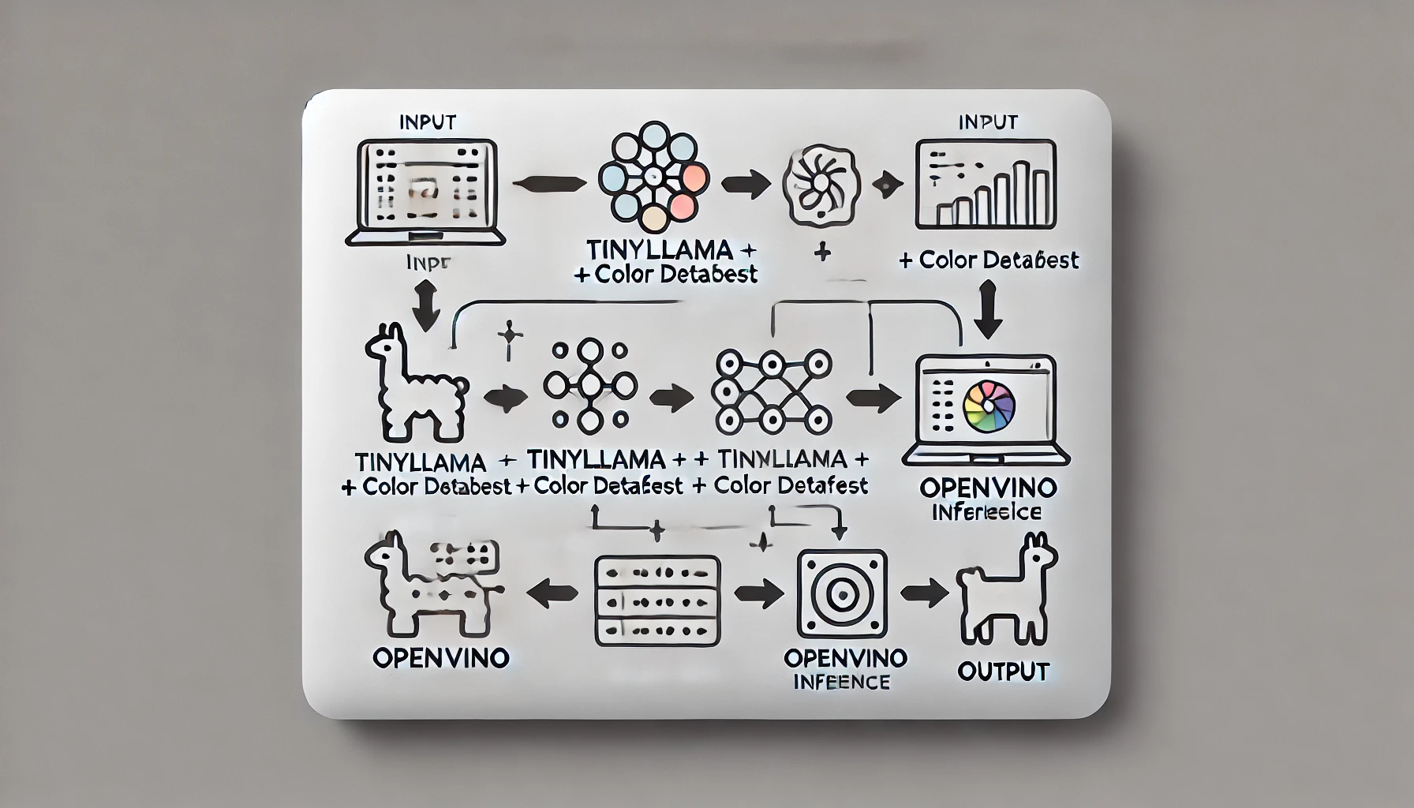
PROCESS FLOW:
2. Model Processing
Step: The laptop processes the input using the TinyLlama model.
Details:
Utilizes advanced NLP techniques.
Employs LoRA configuration for efficient fine-tuning.
1. User Input
Step: User inputs a color name or color code (e.g., "light orange color or #007760) into the laptop.
3. Description Generation
Step: The TinyLlama model generates a detailed and contextually rich description of the color.
Details:
Descriptions include comparisons to real-world objects.
Provides insights into common uses of the color.
4. Output Display
Step: The generated description is displayed on the laptop screen.
Details:
User-friendly and engaging output.
Accessible via CPU inference optimized with Intel® OpenVINO™.

Slide 12

Key Uses of the Model:
1. E-commerce and Product Descriptions
Automated Descriptions: Generates detailed and accurate product descriptions based on color attributes, enhancing online product listings.
Search Optimization: Improves search algorithms by providing precise color descriptions, aiding customers in finding products quickly.
2. Fashion and Design Industry
Trend Analysis: Analyzes color trends over time, helping designers create products that align with current market preferences.
Color Matching: Assists in ensuring color consistency across different materials and products, crucial for design accuracy.
3. Marketing and Advertising
Brand Identity: Helps in creating a strong and consistent brand identity by providing precise color descriptions for branding materials.
Engaging Content: Generates engaging and vivid color descriptions for advertisements, attracting more audience attention.
4. Interior Design
Palette Creation: Aids interior designers in creating harmonious color palettes for rooms or entire homes.
Client Presentations: Provides clients with precise color descriptions, helping in visualizing and agreeing on design choices.

Slide 13
Key Uses of the Model:
5. Digital Content Creation
Graphic Design: Assists graphic designers in selecting and describing colors for digital artwork, ensuring consistency and precision.
Content Personalization: Tailors digital content to user preferences based on their favorite color descriptions.
6. Education and Research
Color Theory Education: Aids in teaching students about color theory and its applications using detailed color descriptions.
Psychological Studies: Supports research on the psychological effects of different colors based on their detailed descriptions.
7. Augmented Reality (AR) and Virtual Reality (VR)
Realistic Rendering: Enhances the realism of AR and VR environments by using accurate color descriptions.
Color Customization: Allows users to customize the colors of virtual objects with precise descriptions.
8. Data Visualization
Enhanced Visuals: Improves the quality of data visualizations by using precise color descriptions to make charts and graphs more informative and aesthetically pleasing.
Accessibility: Ensures that visualizations are accessible to those with color vision deficiencies by providing clear descriptions.

Slide 14
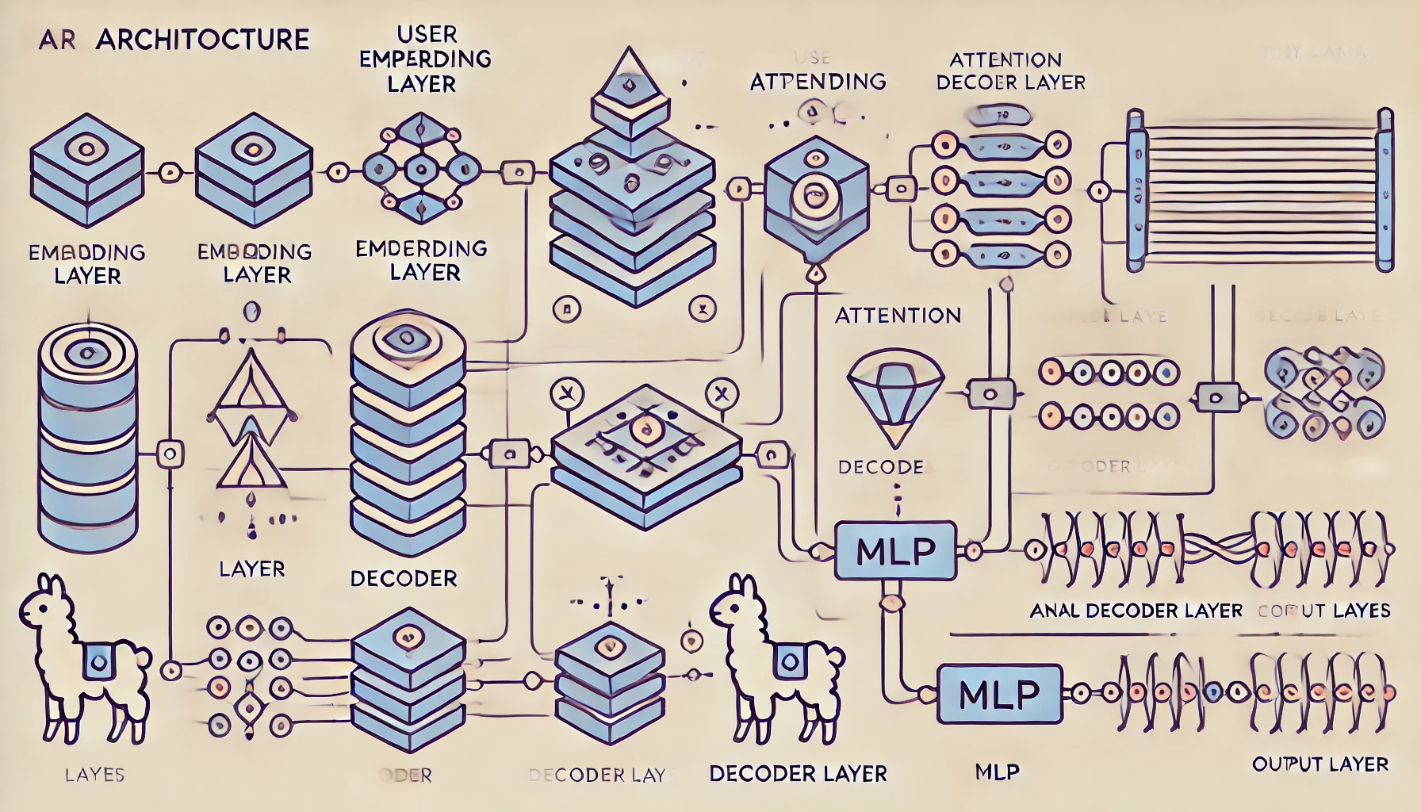

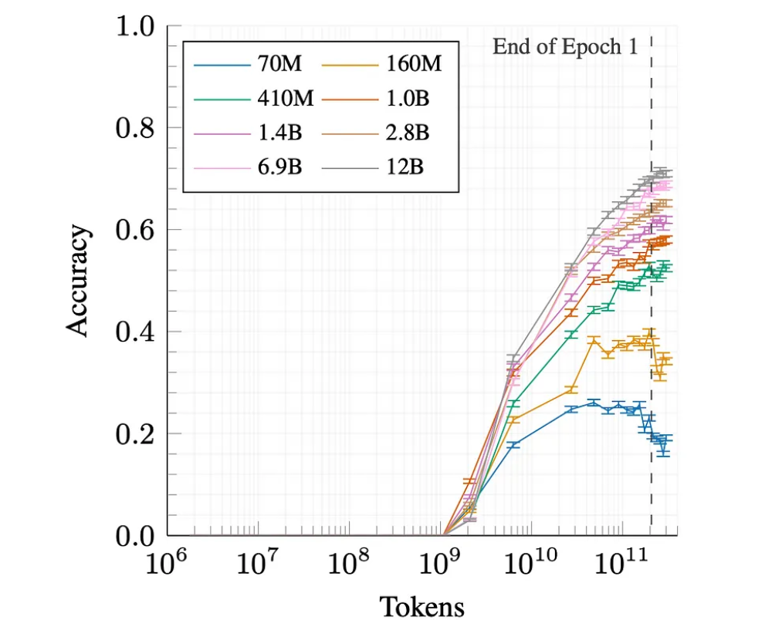

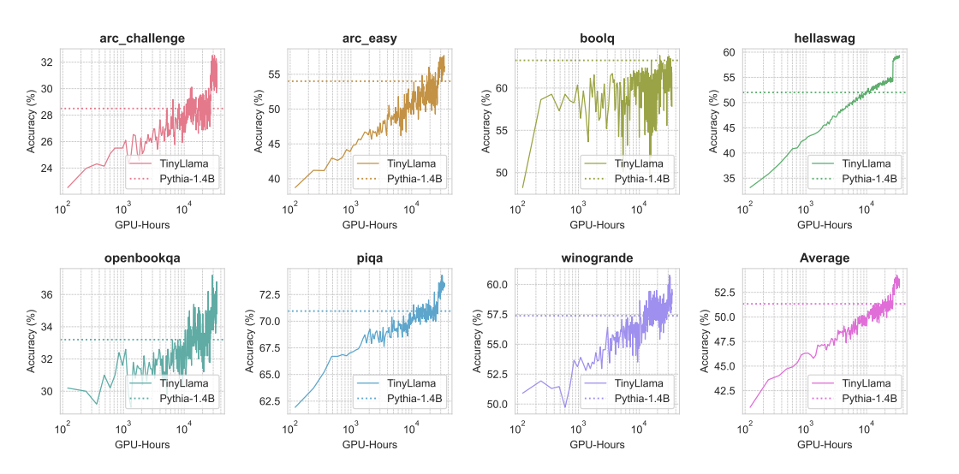

Slide 15
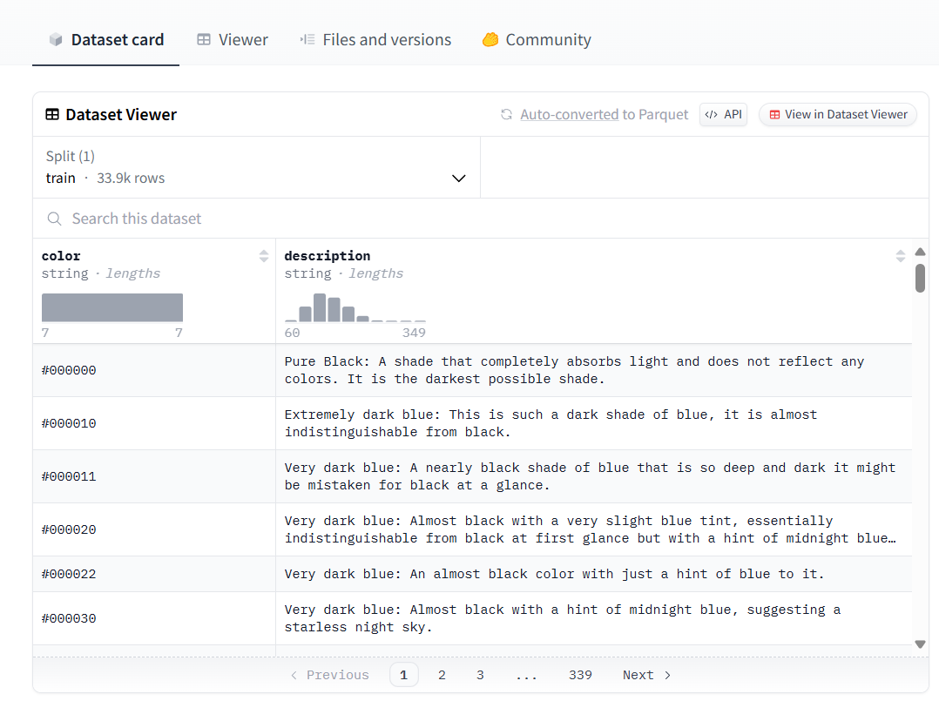
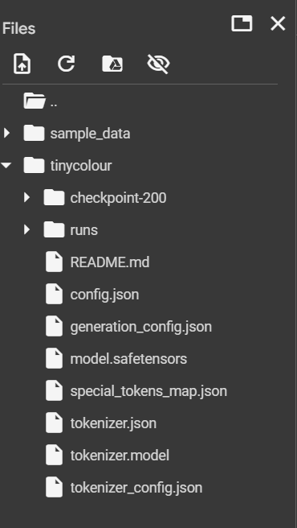
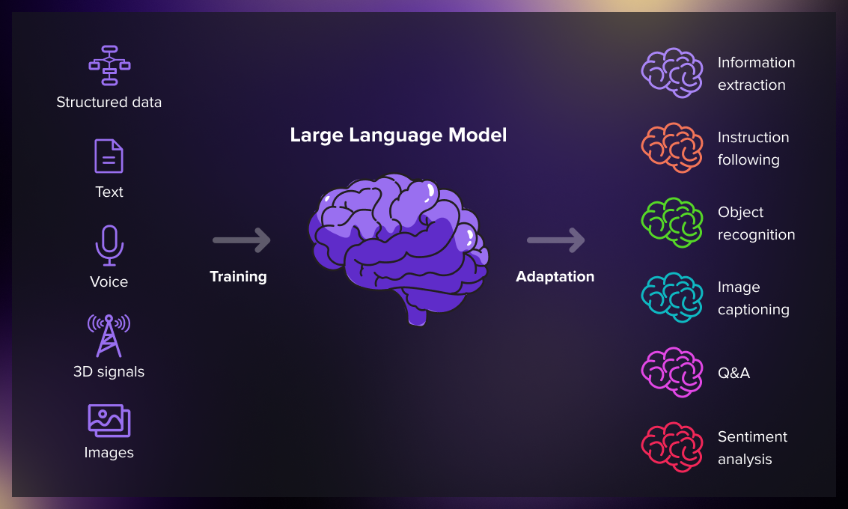
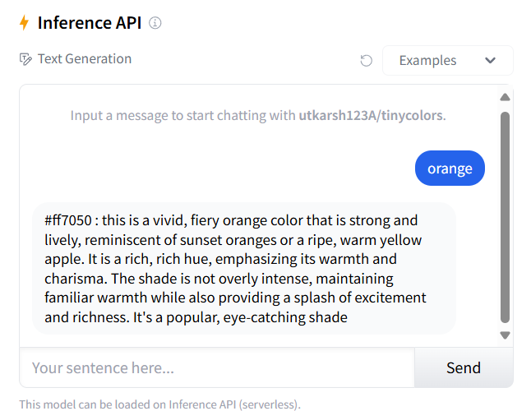
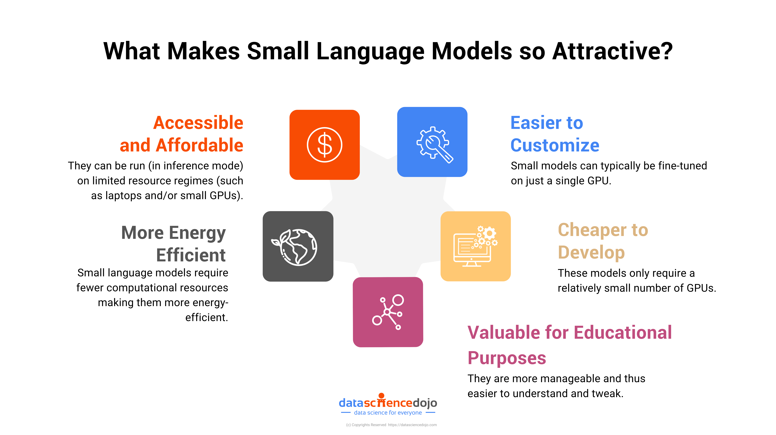

Slide 16
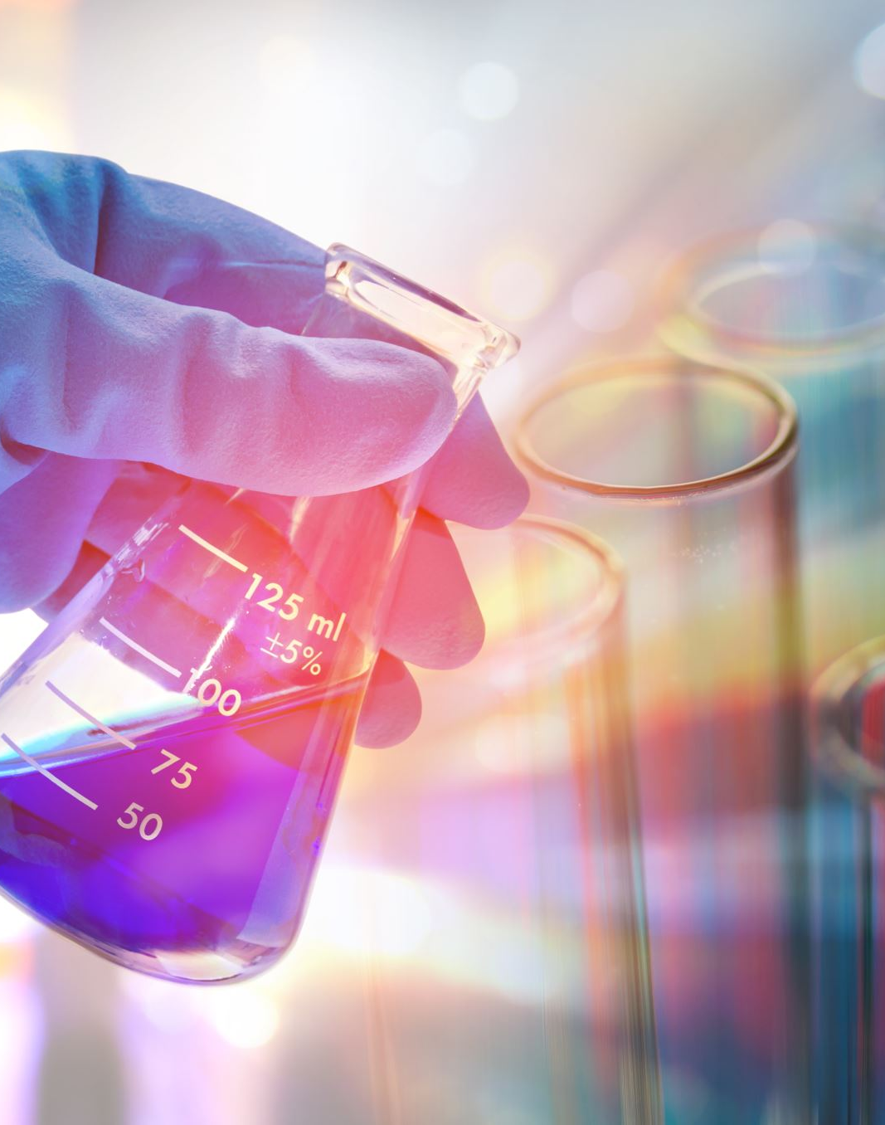
Conclusion

